Slide 2
INFO 6210 Final Exam
Topic: University Model Database
Sreevatsan Athinarayanan
INFO 6210
Athinarayanan.s@husky.neu.edu

Slide 3
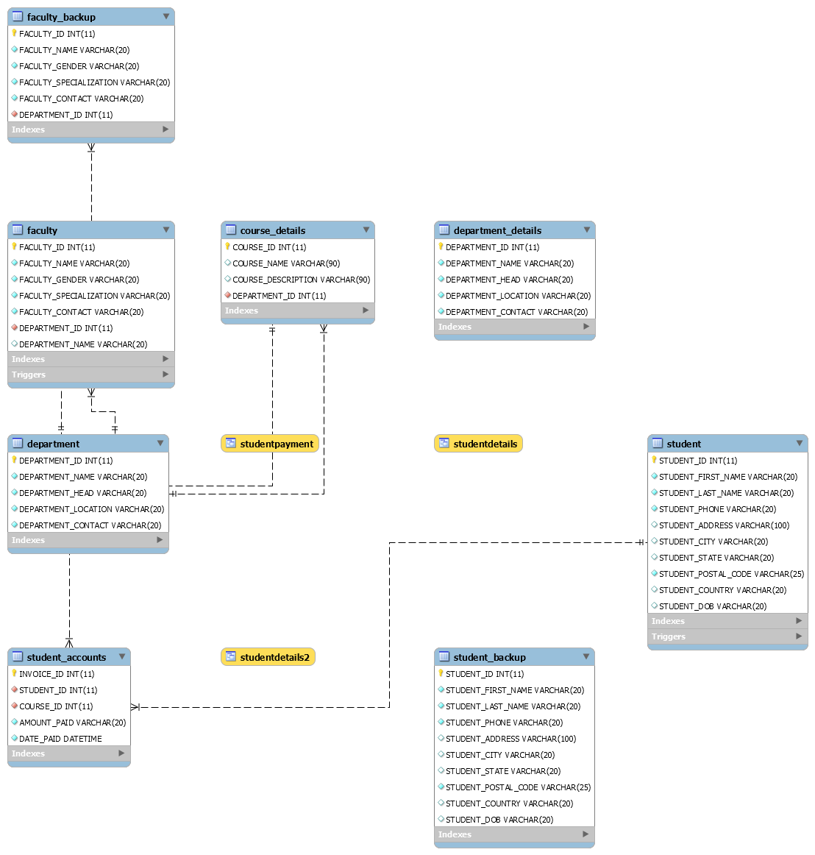
ER Diagram

Slide 4
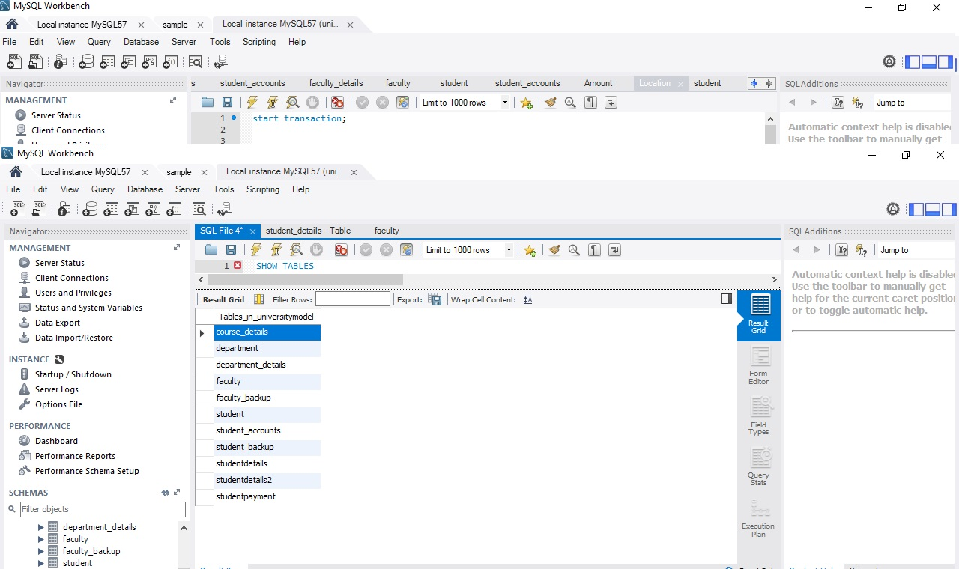
Create Tables

Slide 5
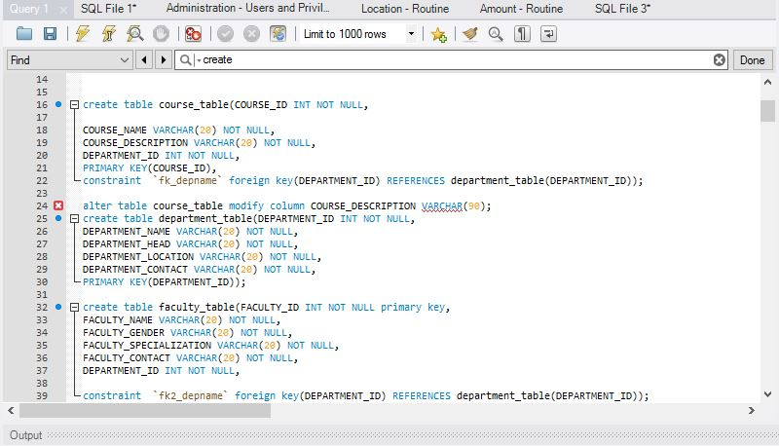
Sample Table (With Foreign Key):

Slide 6
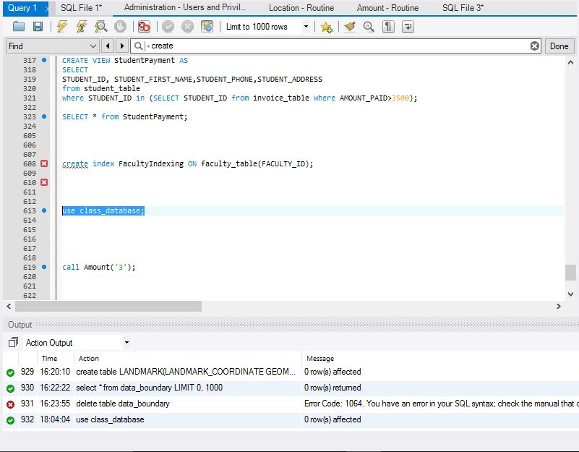
Use Database

Slide 7
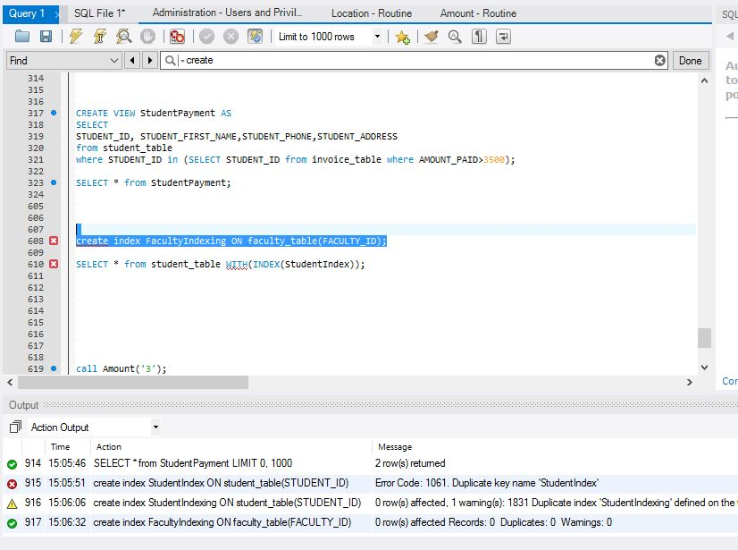
Index
create index FacultyIndexing ON faculty_table(FACULTY_ID);

Slide 8
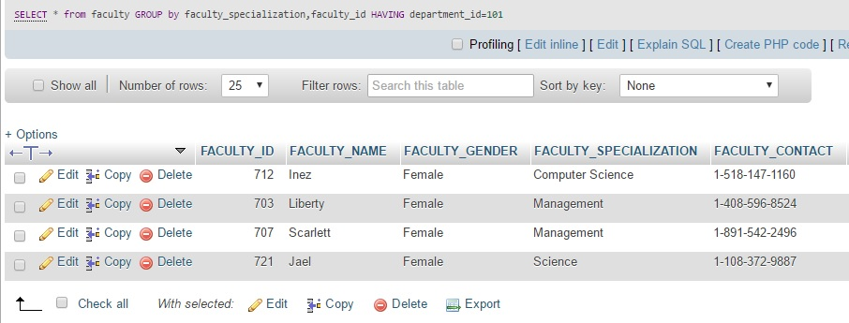
Group By and Having
GROUP BY AND HAVING:
GROUP BY DEPARTMENT_ID
SELECT * from faculty group by FACULTY_SPECIALIZATION HAVING DEPARTMENT_ID=101;

Slide 9
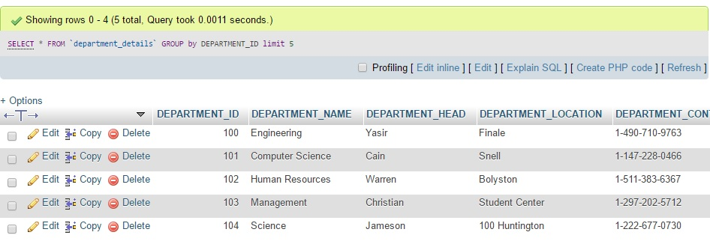
Limit
LIMIT:
SELECT * from student_accounts
order by INVOICE_ID desc
limit 3;

Slide 10
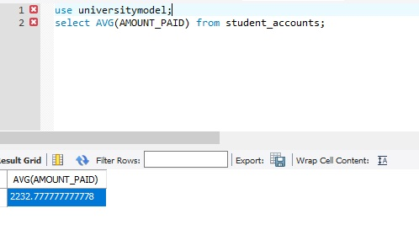
Sample Function
Average:
select AVG(AMOUNT_PAID) from student_account;

Slide 11
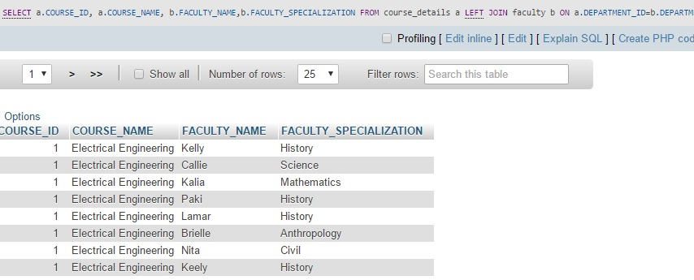
Sample Join
Left Join:
SELECT a.COURSE_ID, a.COURSE_NAME, b.FACULTY_NAME,b.FACULTY_SPECIALIZATION
FROM course_table a LEFT JOIN faculty b
ON a.DEPARTMENT_ID=b.DEPARTMENT_ID;

Slide 12
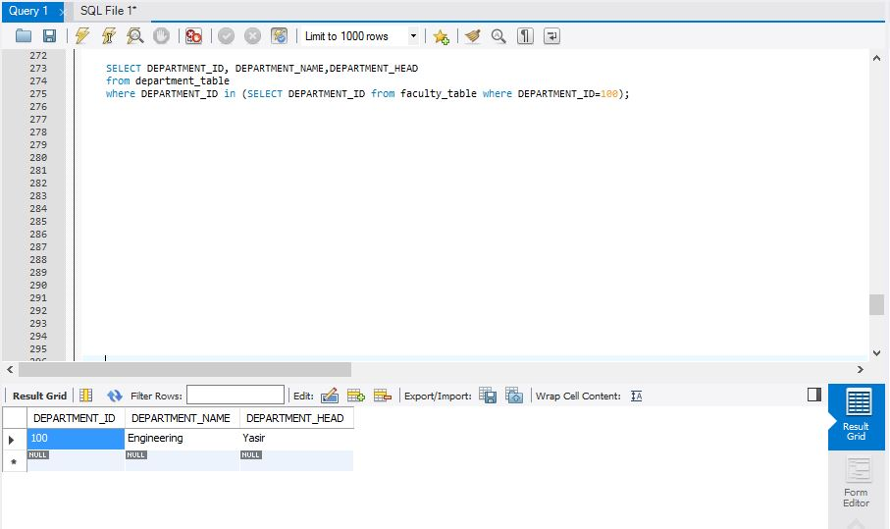
Sample Query
Queries:
SELECT DEPARTMENT_ID, DEPARTMENT_NAME,DEPARTMENT_HEAD from department_table
where DEPARTMENT_ID in (SELECT DEPARTMENT_ID from faculty_table where DEPARTMENT_ID=100);

Slide 13
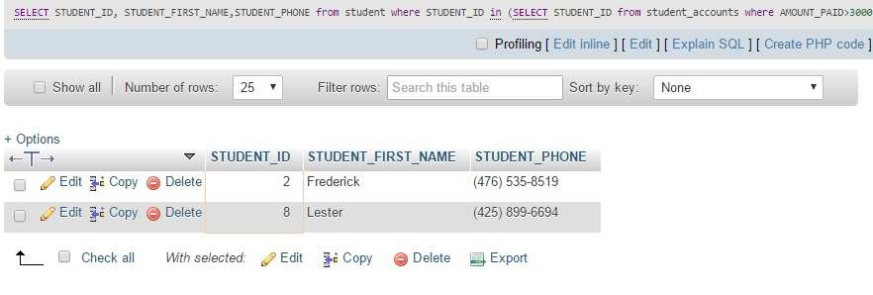
Sample Subquery
Queries:
SELECT STUDENT_ID, STUDENT_FIRST_NAME,STUDENT_PHONE
from student
where STUDENT_ID in (SELECT STUDENT_ID from student_accounts where AMOUNT_PAID>3000);

Slide 14
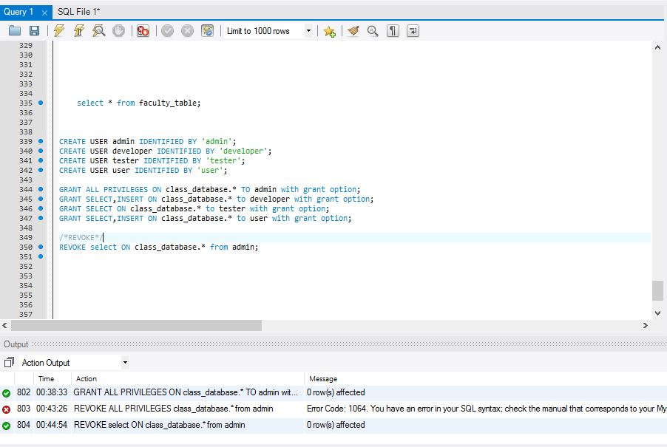
User Privileges:
CREATE USER admin IDENTIFIED BY 'admin';
CREATE USER developer IDENTIFIED BY 'developer';
CREATE USER tester IDENTIFIED BY 'tester';
CREATE USER user IDENTIFIED BY 'user';
GRANT ALL PRIVILEGES ON class_database.* TO admin with grant option;

Slide 15
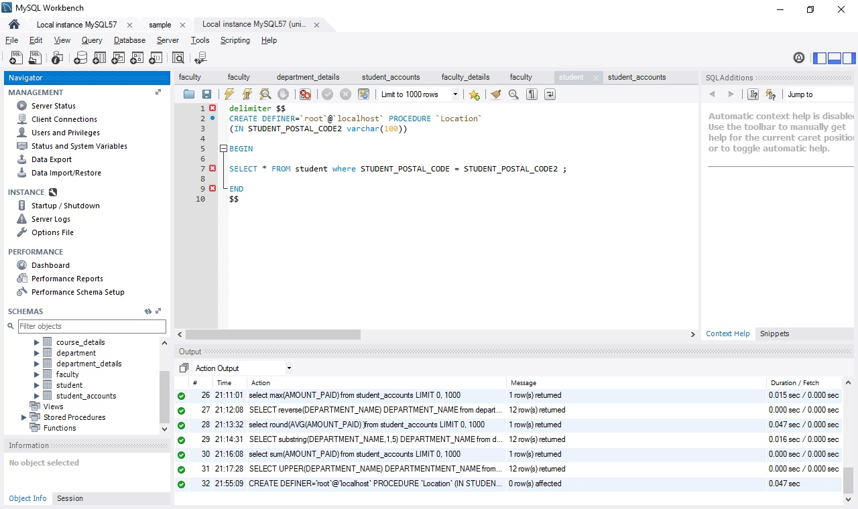
Sample Procedure
Procedure:
CREATE DEFINER=`root`@`localhost` PROCEDURE `Location`(IN STUDENT_POSTAL_CODE2 varchar(100))
BEGIN
SELECT * FROM student_tablewhere STUDENT_POSTAL_CODE = STUDENT_POSTAL_CODE2;
END

Slide 16
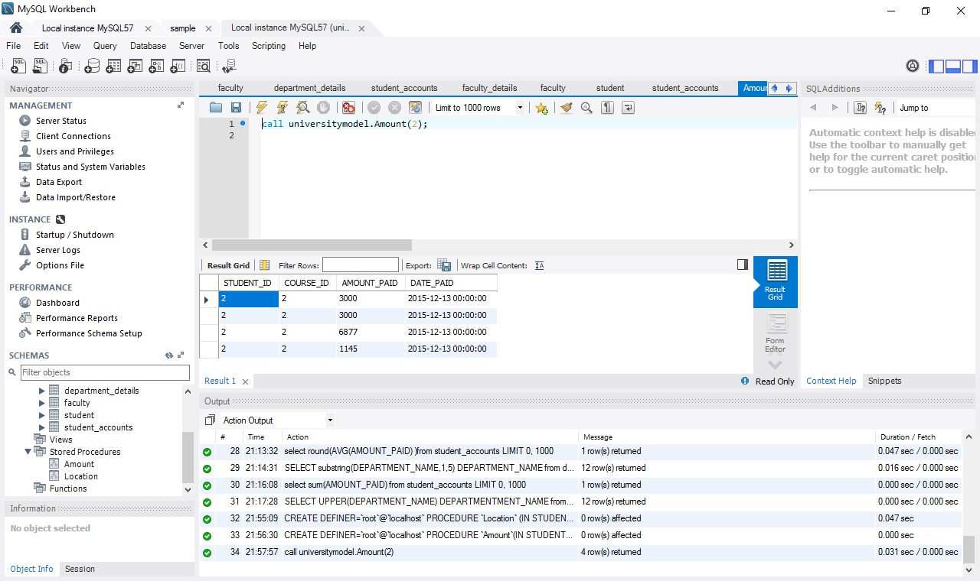
Procedure Result
Result:

Slide 17
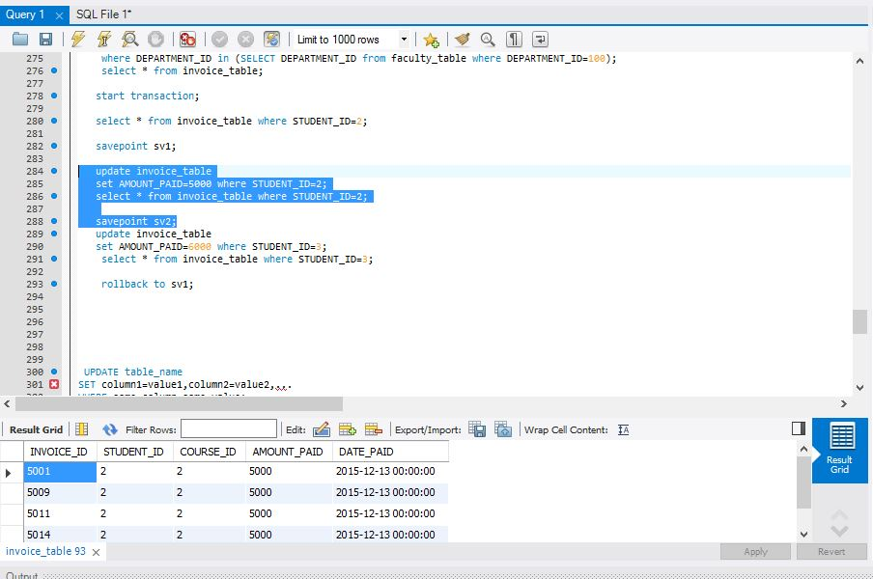
Transaction:
start transaction;
select * from invoice_table where STUDENT_ID=2;
savepoint sv1;
update invoice_table set AMOUNT_PAID=5000 where STUDENT_ID=2;
select * from invoice_table where STUDENT_ID=2;
savepoint sv2;

Slide 18
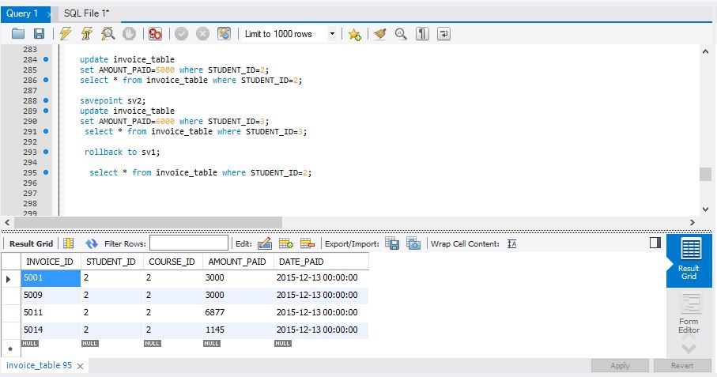
Rollback
Transaction Rollback:
rollback to sv1;
select * from invoice_table where STUDENT_ID=2;

Slide 19
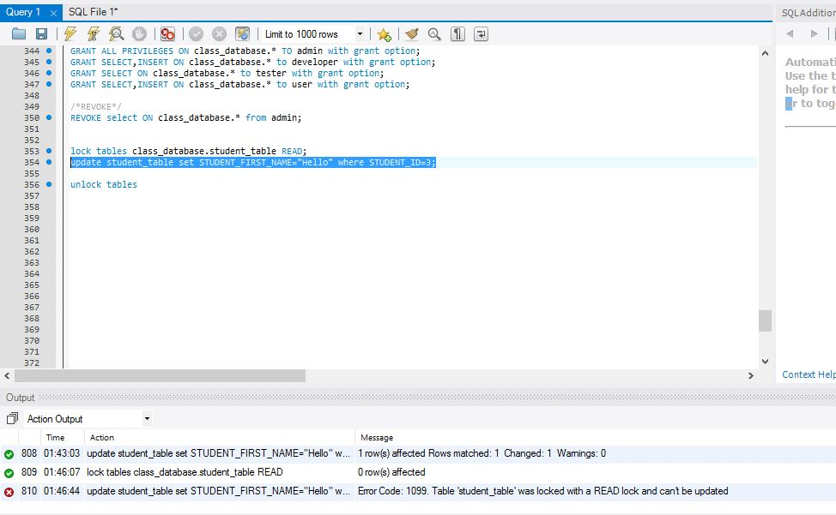
Lock Tables
Lock:
lock tables class_database.student_table READ;
update student_table set STUDENT_FIRST_NAME="Hello" where STUDENT_ID=3;

Slide 20
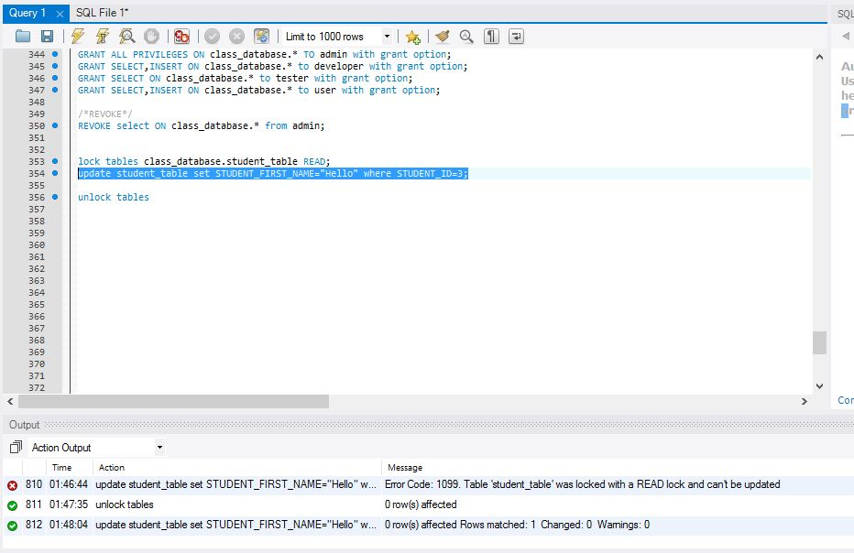
Unlock Tables
Unlock:
unlock tables;

Slide 21
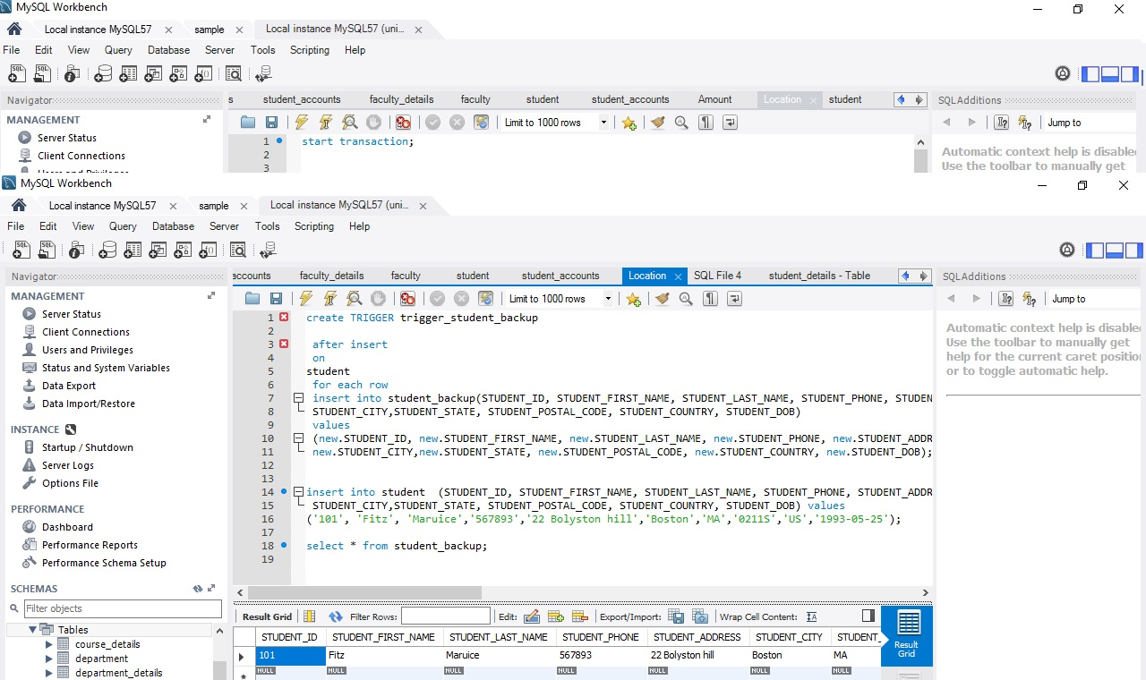
Triggers
Insert Trigger Result:

Slide 22
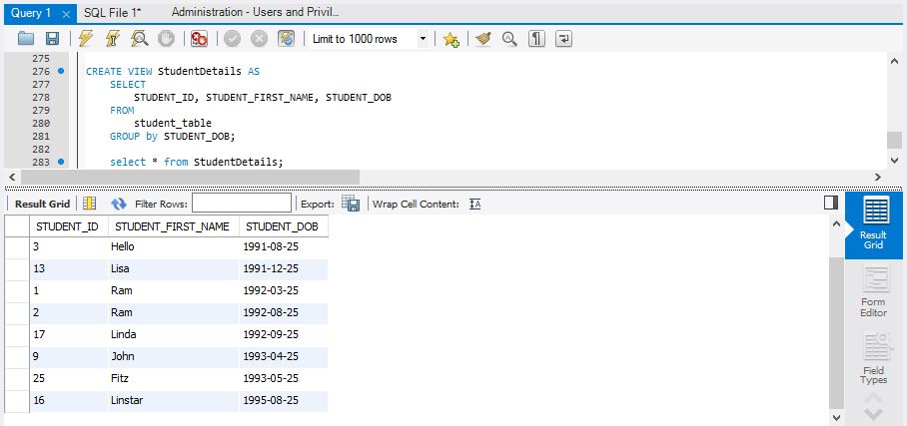
Views
View:
CREATE VIEW StudentDetails AS
SELECT STUDENT_ID, STUDENT_FIRST_NAME, STUDENT_DOB FROM student_table
GROUP by STUDENT_DOB;
select * from StudentDetails;

Slide 23
Backup Schedule:
Full Backup: Every Fridays
Incremental backup: All Days Except Tuesday and Friday
Differential backup: Tuesdays

Slide 24
References
[1] https://en.wikipedia.org/wiki/Extract,_transform,_load
[2] https://docs.oracle.com/cd/B19306_01/server.102/b14223/ettover.htm
[3] https://en.wikipedia.org/wiki/Data_warehouse
[4] http://www.webopedia.com/TERM/U/unstructured_data.html
[5] https://en.wikipedia.org/wiki/Unstructured_data
[6] https://www.quora.com/What-is-the-difference-between-business-intelligence-data-warehousing-and-data-analytics

